Slide 1

Mobile-Credit Seller Prediction
PM & DEPLOYMENT - GROUP C
Aulia Lazuardi M.
Damario Abdalla
Muhammad Thowwafi Alfiansyah

Slide 2
Background & Objective
For many telecom companies, predicting the number of mobile credit seller in an area remains a problem. Since if they could predict the number, they could provide customer service & sales support efficiently on those area.
The goal of the project is to build a model which predict the number of mobile credit seller in an area with at least R2 score of 0.7 and RMSE ~300.
The expected input payload will be data batch from the user of the expected features and its output would be the number of the predicted mobile-credit seller
🎯

Slide 3
Project Architecture
Training Data
Internal Data
Model Comparison
&
Hyper Parameter Tuning
Pre-Processing
(imputation/cleansing)
Model
Normalization
External Data (BPS)
Test Data

Slide 4

Data Insight Gathering

Slide 5
Features Data Type
Numerical Data
Categorical Data
Jumlah_Kelurahan Desa
PDRB
PDRB_per_Kapita
Indeks_Pembangunan_Manusia
Jumlah_Penduduk
Luas_Wilayah
Dana_Alokasi_Umum
Pengeluaran_Riil_per_Kapita_per_Tahun
Nilai_UMR
Jumlah_Penduduk_Miskin
Jumlah_Penduduk_Bekerja
Pengguna_Internet
Pemilik_Ponsel
Jumlah_Agen_Pulsa(Target)
Kota_Kabupaten
Provinsi
Area
Regional

Slide 6
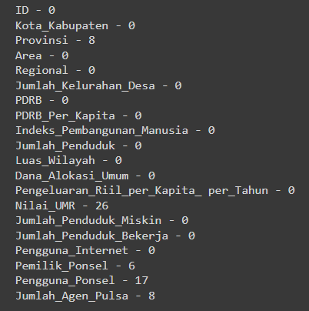
Check Missing Values
There are 5 Features with missing values and the highest was
Nilai_UMR with 26 Missing Values.
In imputing the values, the main idea is whether to impute the missing values by:
Median/Mean
External Data
In our case, we will decide the method based on the features itself.

Slide 7
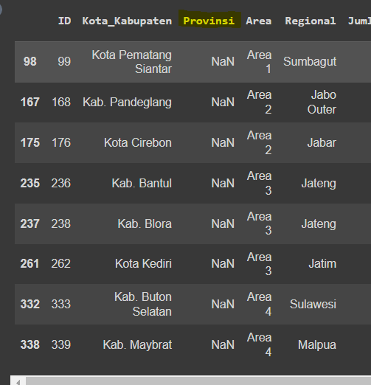
Check Missing Values
Provinsi Feature
In “Provinsi” Feature, there are 8 missing values. However, as we can see that imputing these values could not rely on median of the data
Hence, we have to rely on external sources/ our own knowledge to impute the values. In this case, it is easily filled with knowledge from google (eg. Pematang Siantar is located in Sumatra Utara province, hence it is imputed).
We do this for all other Provinsi.

Slide 8
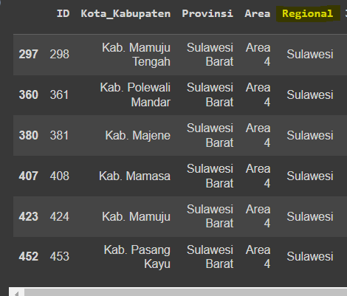
Check Missing Values
Pemilik_Ponsel Feature
In Pemilik_Ponsel Feature, coincidently they are from the same region, which is “Sulawesi Barat”.
For this feature, it is best to impute the values from the data median. However, instead of the median of all Indonesia, we only use the median for Sulawesi Island.

Slide 9
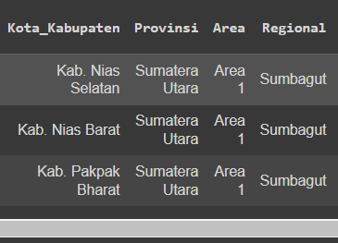
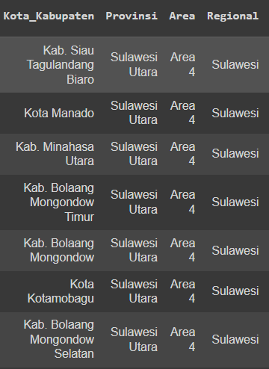
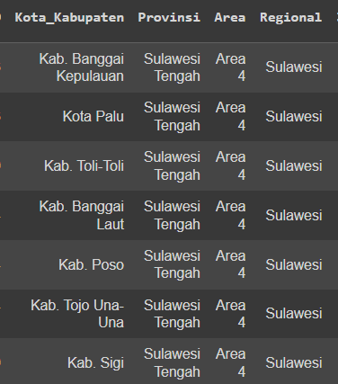
Check Missing Values
Nilai_UMR feature
As for the missing Nilai_UMR Values (26 missing values), as we know, UMR (minimum wage) is quite unique for each region. Hence, we will use external data to impute the missing values.
The provinces with missing values are:
Sumatera Utara (3.222.526)
Sulawesi Utara (3.310.000)
Sulawesi Tengah (2.390.739)

Slide 10
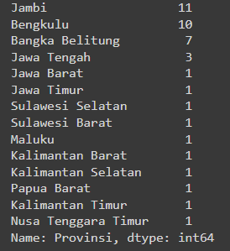
Check Missing/Null Values
Nilai_UMR feature
However, after we impute the missing UMR values, we discovered that some of the Provinsi have zero values (total of 41 null values).
Similar to previous imputation, we rely on google/bps data for the minimum wage of these provinces.

Slide 11
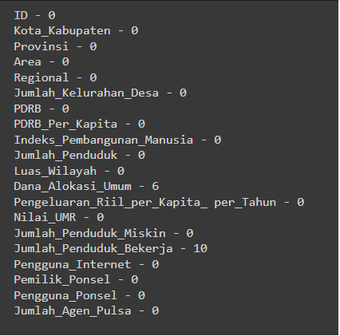
Check Null Values
After imputing the Nilai_UMR, the features left to handle are:
Dana_Alokasi_Umum (6 null values)
Jumlah_Penduduk_Bekerja (10 Null values)
For Dana_Alokasi_Umum feature, we will impute the median of the area for the Dana_Alokasi_Umum (since we could not get the data easily on internet).
While for the Jumlah_Penduduk_Bekerja, we will gather information from BPS and impute the number.

Slide 12

Pre-Processing & Feature Engineering/Selection

Slide 13
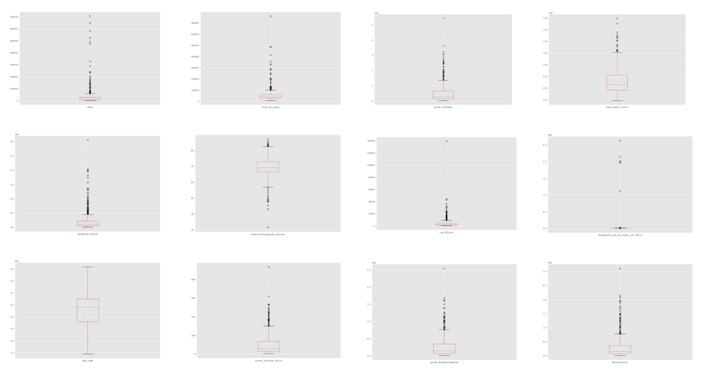
Outlier Checking
One of the ways to check Outliers in the data is to see its distribution. In our case, we will check the distribution by the
Boxplot of all numerical values to see its IQR (InterQuartile Range) of the data.
It is very obvious that almost every feature, the outliers are in abundance.

Slide 14
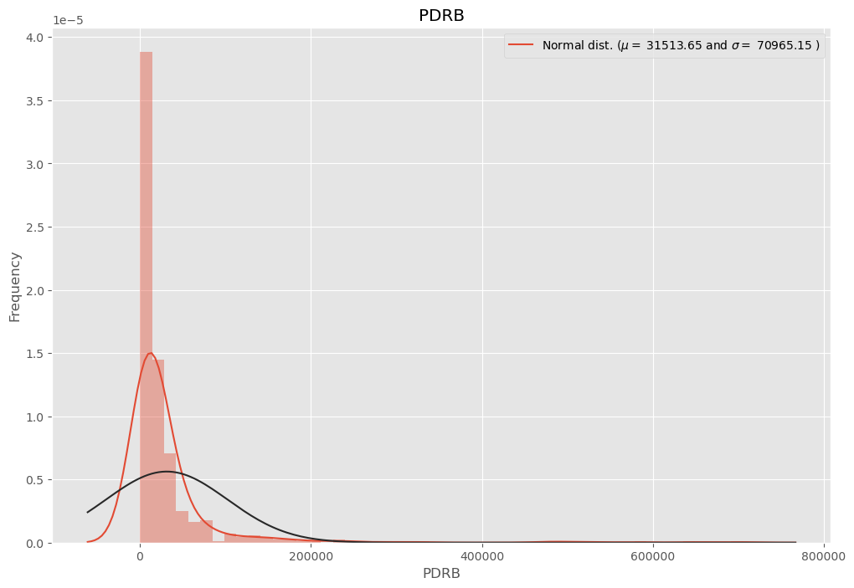
Outlier Checking
If we look at PDRB feature, we could see that the distribution are heavily skewed to the right.
One of the ways to handle outlier is to remove them. However, since the outlier in every feature are very plenty, we suggest to transform them into Log-features.

Slide 15
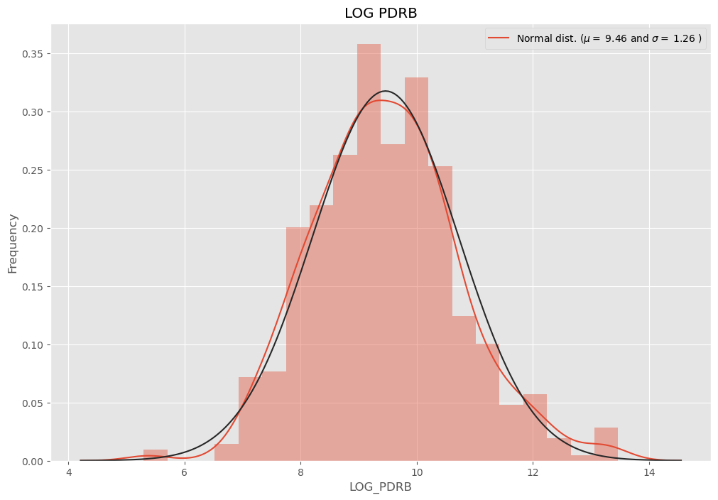
Outlier Checking
After we transformed the feature into Log-PDRB, we could see that the data distribution are almost symmetric and very few outliers.
Consequently, we will log-transform all the numerical features before feeding it into the model.

Slide 16
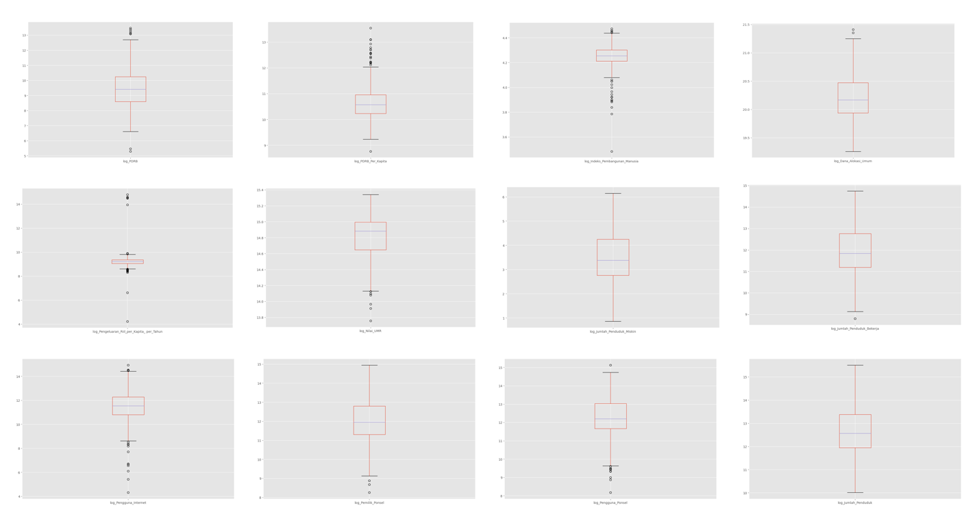
Outlier Checking
After we log-transform the features, even though the outliers are still there, but the distribution are not heavily skewed and we deemed it is feasible to be run into the model.
One of the main reason we still would not remove the outliers is our dataset is not that big and every city/region has its own data. Removing them would be a huge mistake.

Slide 17
Label Encoding
For categorical features, we encode it into numerical values. However, since the Provinsi and Regional feature is highly similar, we remove it and will be represented by Regional.
Regional | Encode
Sumbagsel | 1
Lampung | 2
Sumbagut | 3
Sumbagteng | 4
Jabar | 5
Jabo Inner | 6
Jabo Outer | 7
Jatim | 8
Jateng | 9
Sulawesi | 10
Kalimantan | 11
Malpua | 12
Balnus | 13
Area | Encode
Area 1 | 1
Area 2 | 2
Area 3 | 3
Area 4 | 4
Area 5 | 5

Slide 18
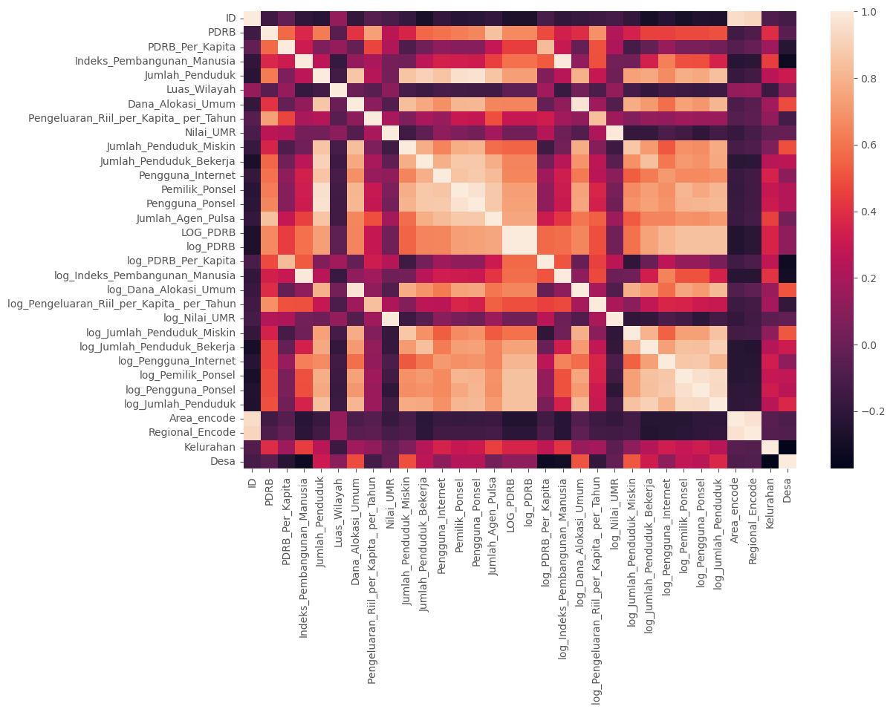
Correlation
Heat map
After we mapped the correlation between the features, some of them shown some clustering between features.
However, since we are interested in features with high-correlation with the target (Jumlah_Agen_Pulsa), we see that there are no prominent feature that highly correlates with the target. Hence, firstly we will input all the log-transformed feature into the baseline model.

Slide 19

Baseline Model & Selection

Slide 20
Baseline Regression Model
As first baseline model, we will use Linear Regression Model with skicit-learn’s LinearRegression.
All the features used are the transformed log-features (except the target).
The training set consists of 66% data and Test Set of 33% data. Randomized with random_state = 42
First Baseline Result:
R² Score | 0.6177
RMSE (Root Mean Square Error) | 315.37
The models performs not bad for first run, even though still short of our objective and goal.
Next, we will look at the coefficient on the linear regression model.

Slide 21
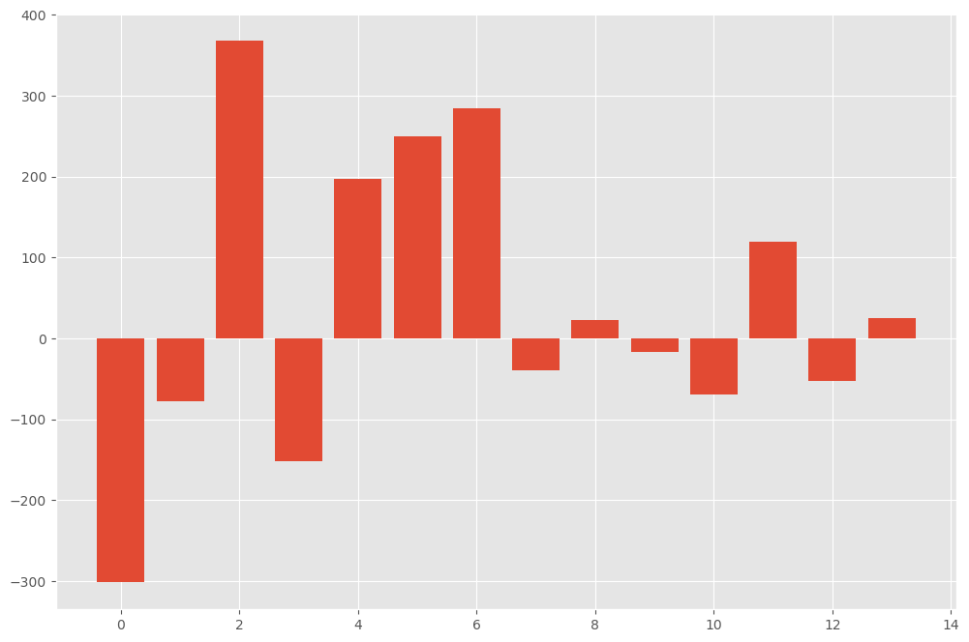
Baseline Regression Model
Feature Names | Feature Label | Score
Log_PDRB_Per_Kapita | Feature 0 | -301.741
Log_indeks_Pembangunan_Manusia | Feature 1 | -78.028
Log_PDRB | Feature 2 | 367.723
Log_jumlah_Penduduk | Feature 3 | -151.655
Log_Dana_Alokasi_Umum | Feature 4 | 197.684
Log_Pengeluaran_Riil_per_Kapita_per_tahun | Feature 5 | 249.91
Log_nilai_UMR | Feature 6 | 283.989
Log_jumlah_Penduduk_Miskin | Feature 7 | -39.893
Log_jumlah_Penduduk_Bekerja | Feature 8 | 22.394
Log_Pengguna_Internet | Feature 9 | -16.741
Log_Pemilik_Ponsel | Feature 10 | -69.362
Log_pengguna_Ponsel | Feature 11 | 119.615
Area_encode | Feature 12 | -52.610
Regional_encode | Feature 13 | 24.414
Most important feature will be the log_PDRB
Surprisingly, least important feature is the Log_pengguna _Internet

Slide 22
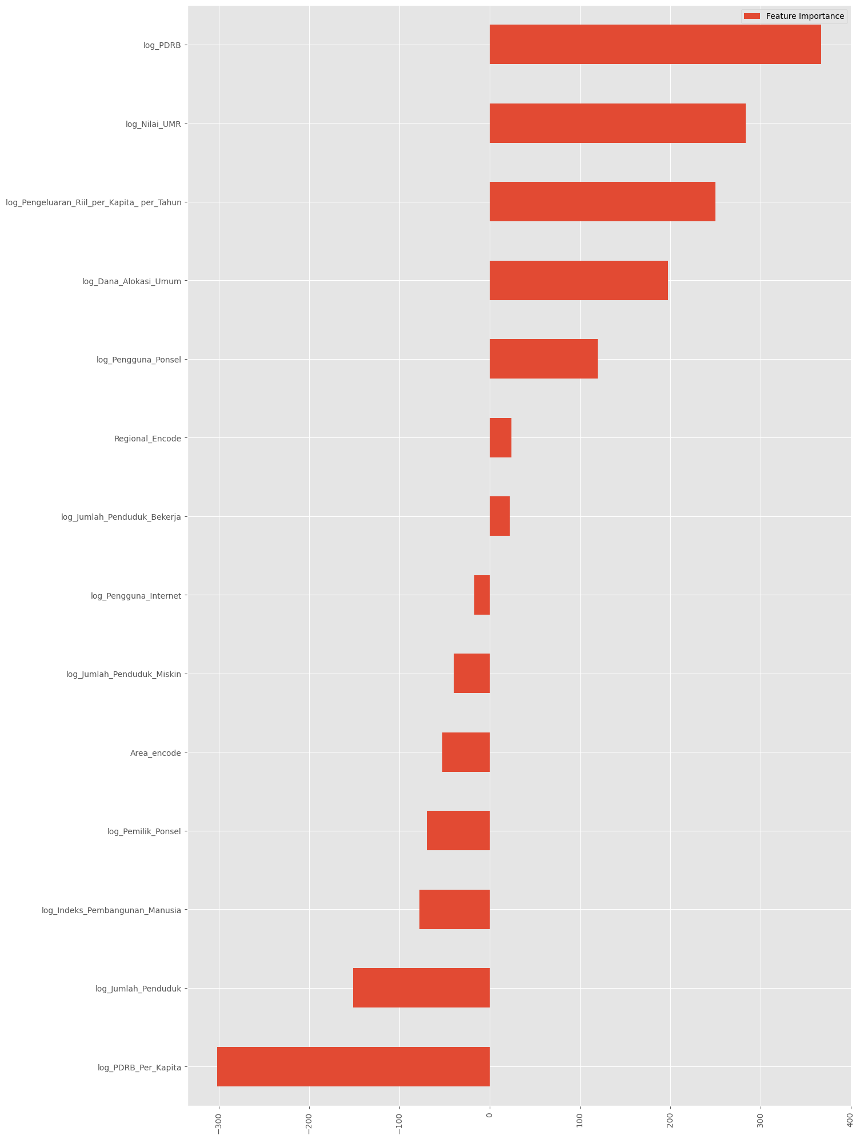
Baseline Lasso Regression Model
The feature importance between regular regression model & the lasso regression consists the same.
Log_PDRB, Log_PDRB_per_Kapita & log_nilai_UMR are the most important features for the target.
Log_pengguna_internet remains the least important feature.
Log_PDRB | 367.486
Log_nilai_UMR | 283.966
Log_Pengeluaran_Riil_per_Kapita_per_tahun | 249.902
Log_Dana_Alokasi_Umum | 197.644
Log_pengguna_Ponsel | 119.565
Regional_encode | 24.409
Log_jumlah_Penduduk_Bekerja | 22.392
Log_Pengguna_Internet | -16.746
Log_jumlah_Penduduk_Miskin | -39.87
Area_encode | -52.594
Log_Pemilik_Ponsel | -69.350
Log_indeks_Pembangunan_Manusia | -77.589
Log_jumlah_Penduduk | -151.391
Log_PDRB_Per_Kapita | -301.508

Slide 23
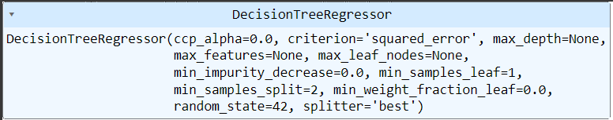
Decision Tree Regression Model
Next we will try scikit-learn’s DecisionTreeRegressor.
The parameters are listed below:
The result of the model are:
R² Score | 0.742
RMSE (Root Mean Square Error) | 258.82
As we can see, it is better than the LinearRegression model and fulfill our objective and goal.
For improvement, we also tried to use hyperparameter tuning with GridSearchCV to find the best combination, but we remove it since it requires tremendous computational power.

Slide 24
Conclusion & Further Improvement
As our model’s performance, the best model to predict the number of mobile-credit seller is the Decision Tree Regression with transforming the features into log-features.
Most important log-features would be the region’s PDRB and UMR, which made a lot of sense regarding the region’s economic purchasing power.
As for the least important feature surprisingly will be the region’s internet user, we hypothesis that internet user does not require to buy mobile credit. Also, this feature perhaps could be improved by dividing it with the jumlah_penduduk
Other suggestions for the feature engineering are to implement the division between features, for example: the working forces and the number of settlers in that area.
For the categorical features, other than label-encoding, one-hot encoding could be applied.
Other hyperparameter tuning methods like RandomSearchCV could be implemented for cutting computational costs.
📈

Slide 25
References
https://towardsdatascience.com/hyperparameter-tuning-in-python-21a76794a1f7
https://machinelearningmastery.com/hyperparameter-optimization-with-random-search-and-grid-search/
http://rasbt.github.io/mlxtend/user_guide/feature_selection/SequentialFeatureSelector/#example-6-feature-selection-with-fixed-trainvalidation-splits
https://scikit-learn.org/stable/modules/generated/sklearn.tree.DecisionTreeRegressor.html

Slide 26
https://github.com/thowwafi/pulse-sales-prediction
- GRUP C - GITHUB LINK

